Slide 1
Event-driven Mistakes

Slide 2




Martin Faartoft
Lead Engineer at
MartinFaartoft
Faartoft

Slide 3
Context
Built a big event-driven system
C# on Azure Service Bus
Millions of events / day
Made a bunch of mistakes
Easy to get started
Hard to make it reliable

Slide 4
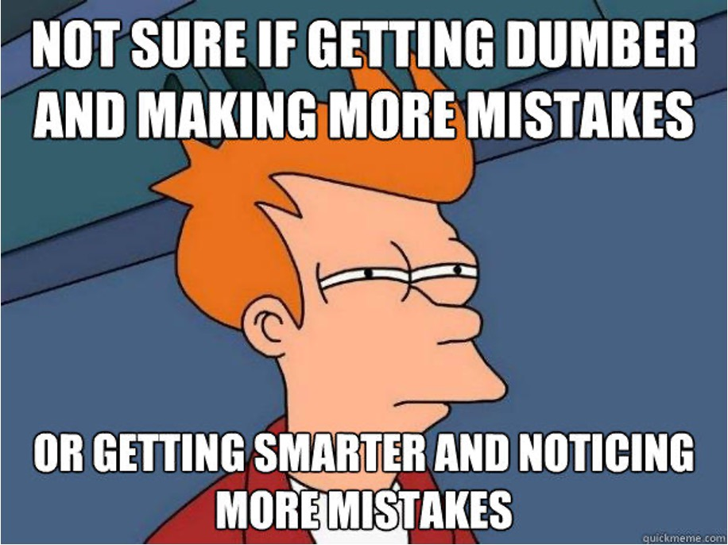

Slide 5
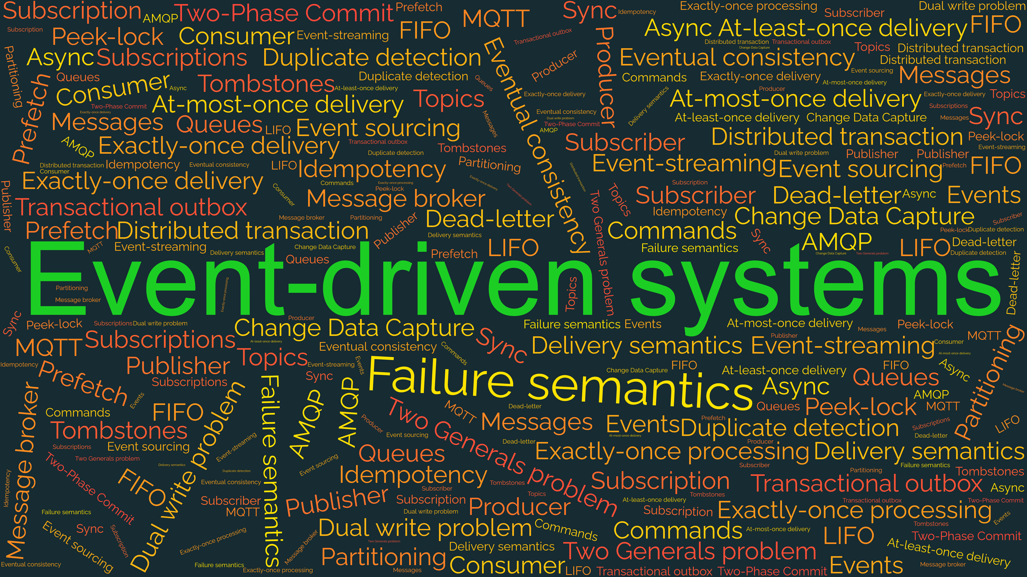

Slide 6
Event-driven systems 101
Fast-forward edition

Slide 7

THING
ASYNC

Slide 8


Slide 9
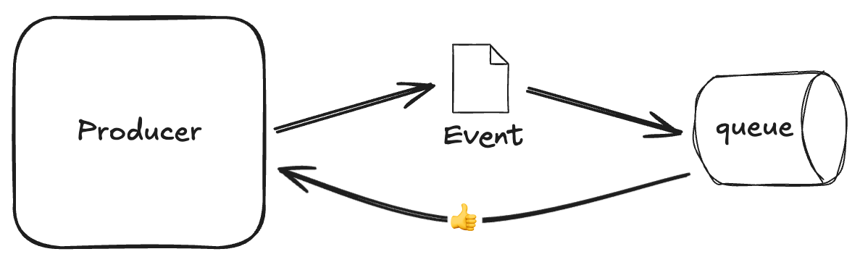
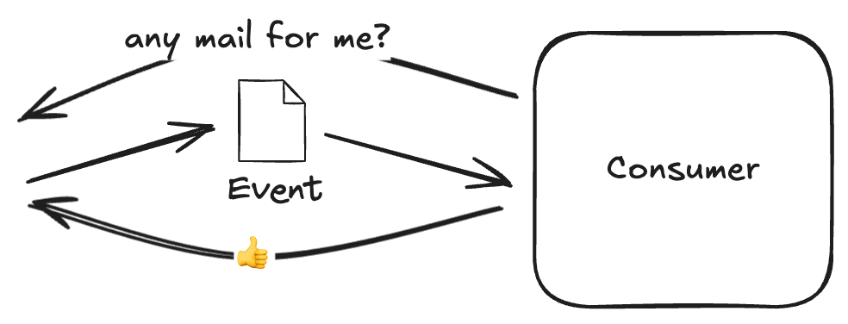
Events 101

Slide 10
Pros & Cons
Pros
Loose coupling
Scaling
(illusion of) Performance
Cons
Complexity
Eventual Consistency
Cost

Slide 11
Why should you care?

Slide 12
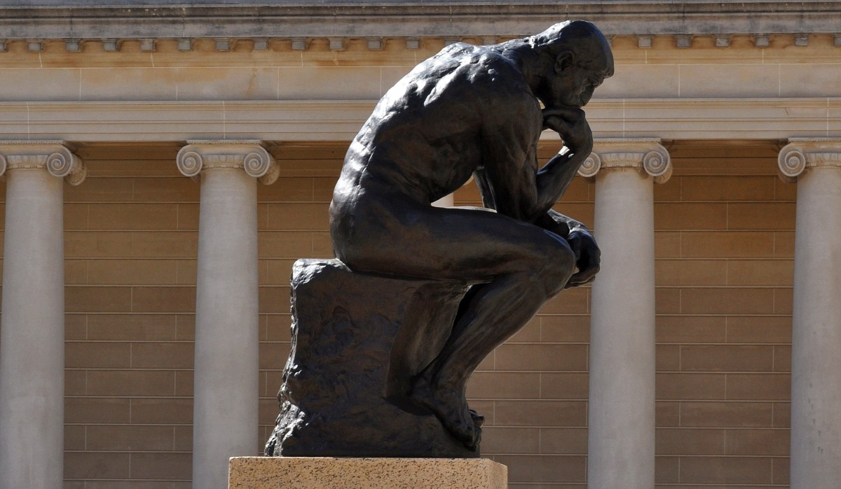
“Any software system is at most 2 steps away from being event-driven” – me

Slide 13
Step 1

Slide 14
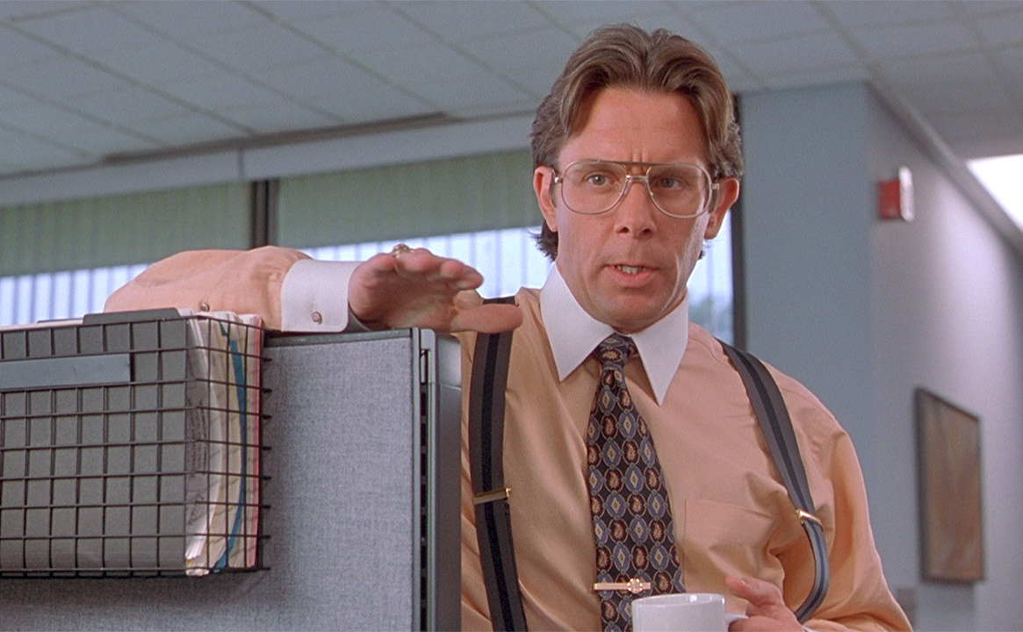
Can we show data from the TPS system?

Slide 15
Step 2

Slide 16
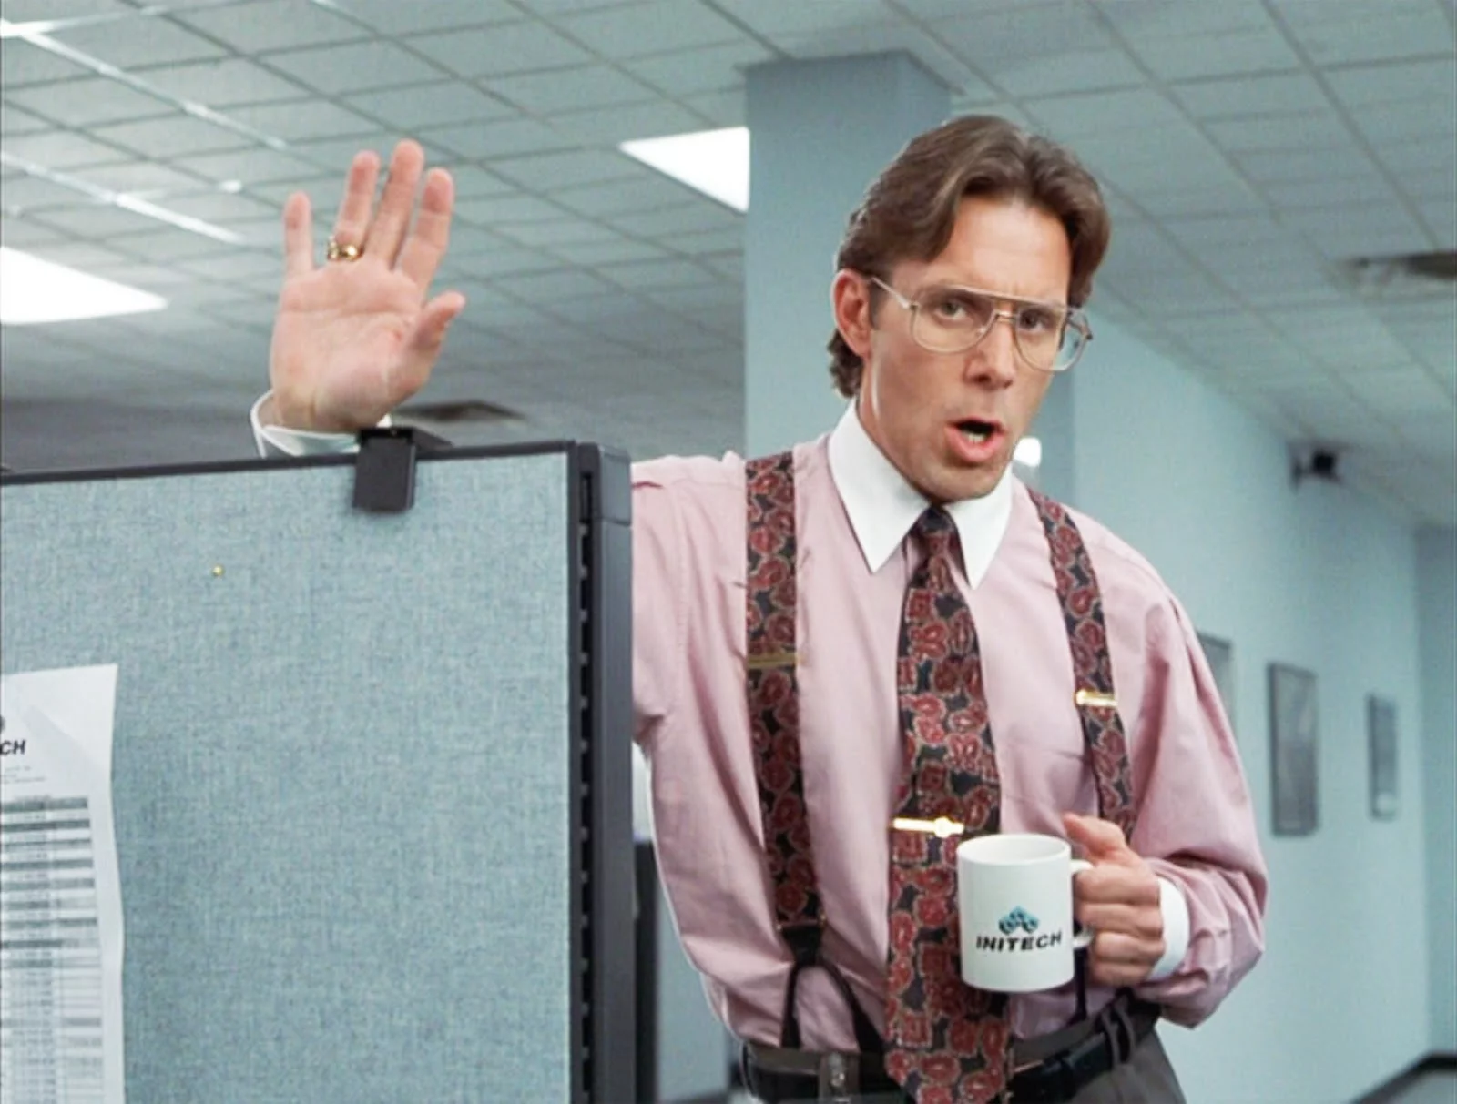
Can we rebuild our report, when TPS data changes?

Slide 17
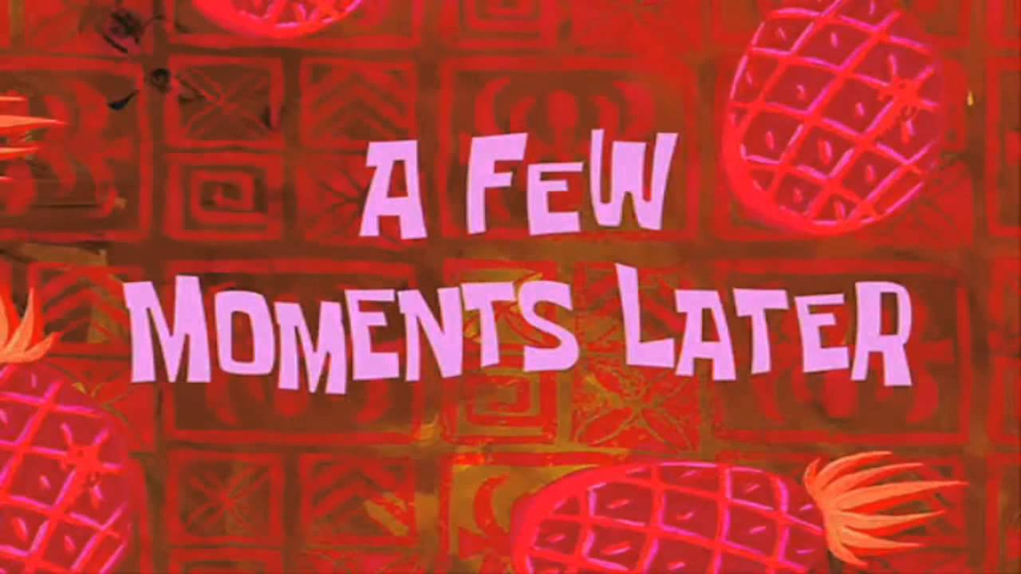

Slide 18
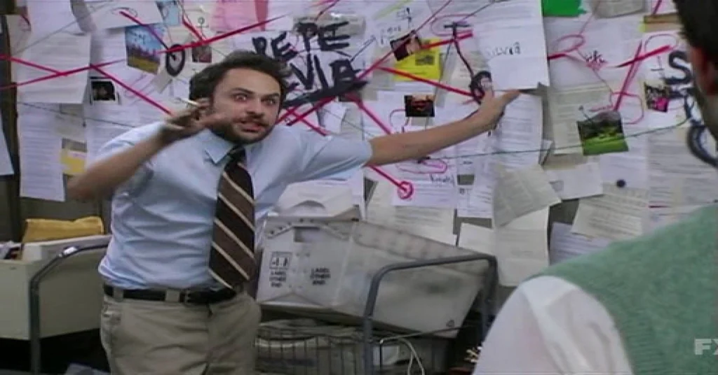
We should replace our database with events!!

Slide 19

Takeaways
Events are not equally important
Performance / reliability trade-off
Events are hard
You have to do your own homework
Think carefully about what can go wrong
Network failures
Application crashes

Slide 21
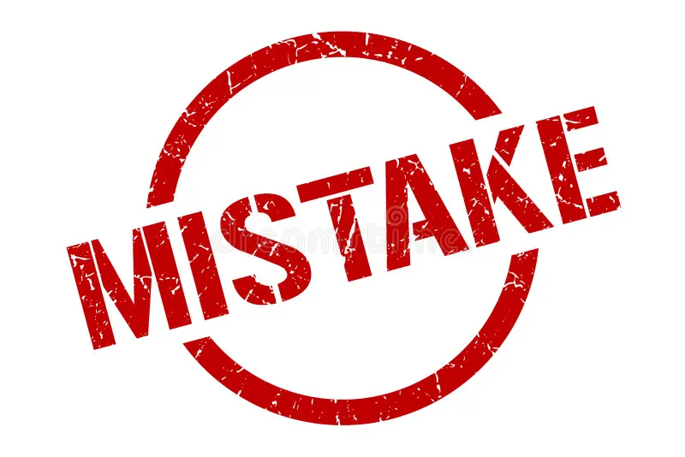
Events are hard

Slide 22
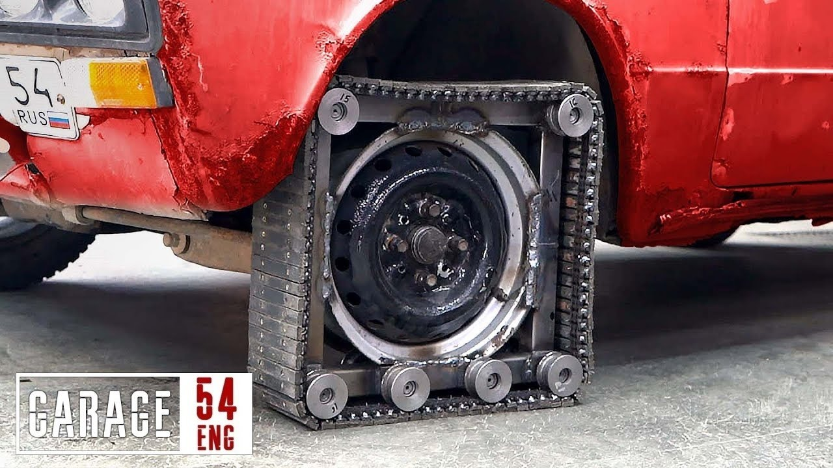
Mistake – Reinvented the wheel

Slide 23

Reinventing the wheel
Symptoms
Devs build frameworks, not features
Only one dev really understands how it works
Not Invented Here

Slide 24

The wheel of despair
“Let’s build it ourselves. Migrating is hard and we invested so much already”
Need new feature
Sunk Cost Fallacy

Slide 25


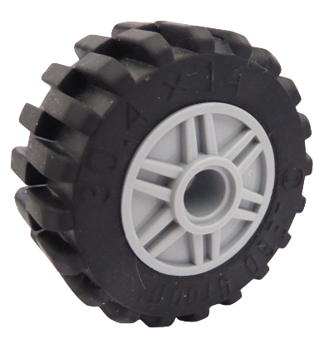
Biting the bullet - Migrating
MassTransit
Rebus

Slide 26
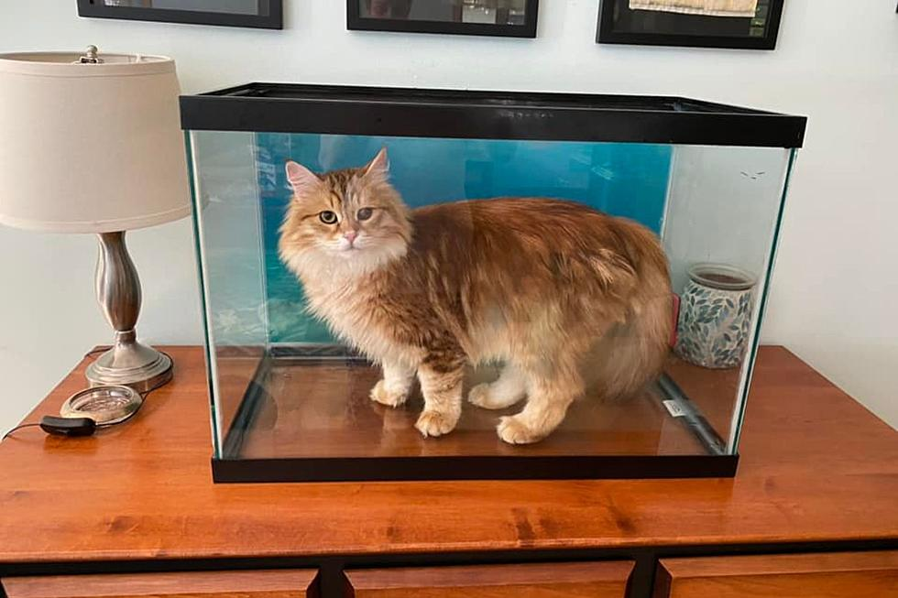
How did I get here?

Slide 27
Mistake – Didn’t store incoming events
Symptoms
State didn’t match source system
No idea why
Couldn’t reproduce errors from logs

Slide 28
Storing events
Stored ALL the events
Indexed important fields
OrderId, CustomerId
Time travel unlocked
Found race condition problems in producer systems
Tracked down elusive bug in intermediate queue

Slide 29
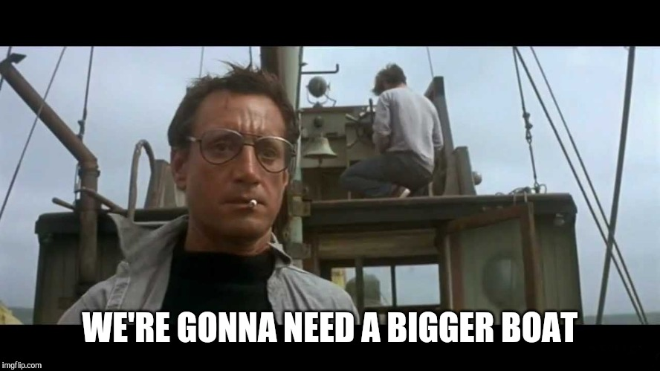
Mistake – Not preparing for scale

Slide 30
Mistake – Not preparing for scale
Symptoms
1M dead-letters piled up over night
No playbook or tools to handle that amount

Slide 31
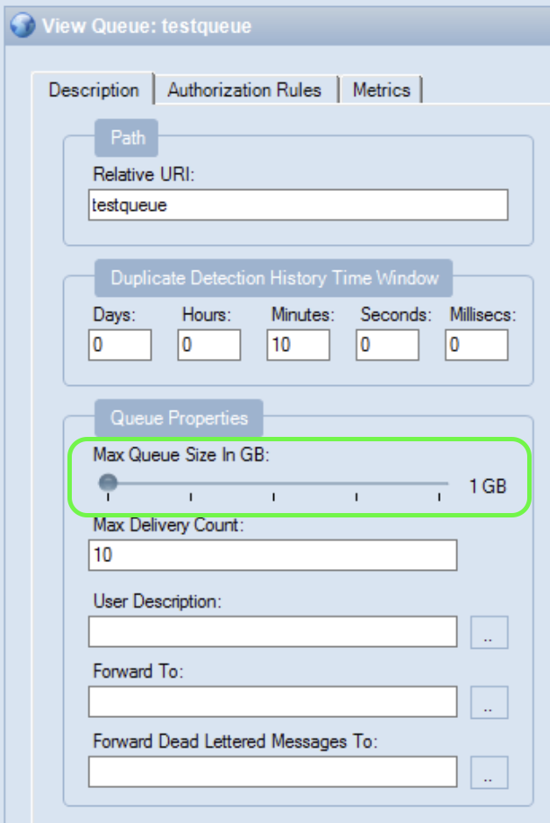
Mistake – Not preparing for scale
Made queues too big
No kill-switch

Slide 33
Didn’t do my homework

Slide 34
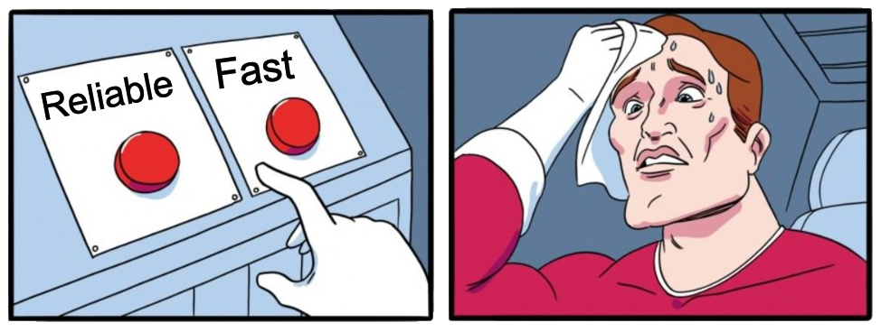

Slide 35
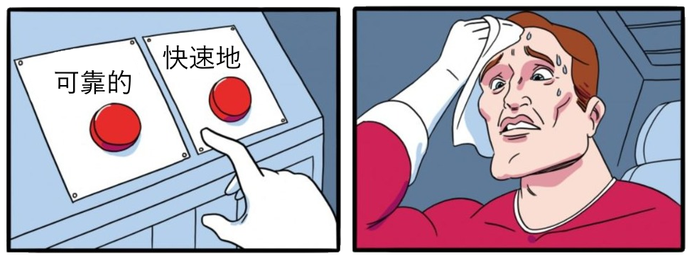

Slide 36
Configuration Quiz
ReceiveMode: ReceiveAndDelete | PeekLock (Service Bus)

Slide 37
Configuration Quiz
ReceiveMode: ReceiveAndDelete | PeekLock (Service Bus)

Slide 38
Configuration Quiz
ServiceBusReceiverOptions.PrefetchCount (Service Bus)

Slide 39
Configuration Quiz
ServiceBusReceiverOptions.PrefetchCount (Service Bus)

Slide 40
Configuration Quiz
AutoCommit: true | false (Kafka, Event Hub)

Slide 41
Configuration Quiz
AutoCommit: true | false (Kafka, Event Hub)

Slide 42
Configuration Quiz
AUTO_ACKNOWLEDGE |
CLIENT_ACKNOWLEDGE |
UNORDERED_ACKNOWLEDGE (Amazon SQS)

Slide 43
Configuration Quiz
AUTO_ACKNOWLEDGE |
CLIENT_ACKNOWLEDGE |
UNORDERED_ACKNOWLEDGE (Amazon SQS)

Slide 44
(Mis)configuration
Naming and documentation quality is inconsistent
Default values are not always great for reliability

Slide 45
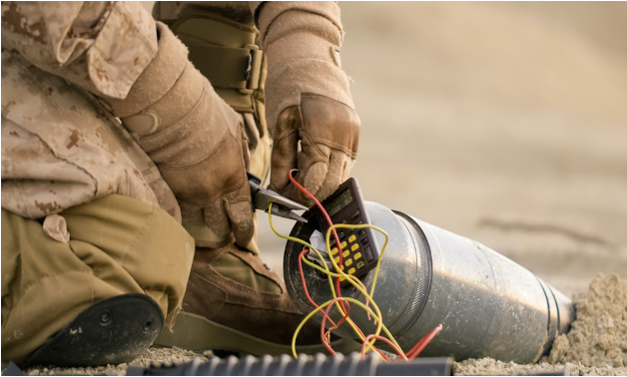
Mistake – Changing Azure ServiceBus tier

Slide 46
Mistake – Changing Azure ServiceBus tier
Symptoms
Could not scale existing instance to ‘Premium’ tier without re-creating
Carefully migrated one queue at a time (without downtime)

Slide 47
Not thinking carefully about what could go wrong

Slide 48
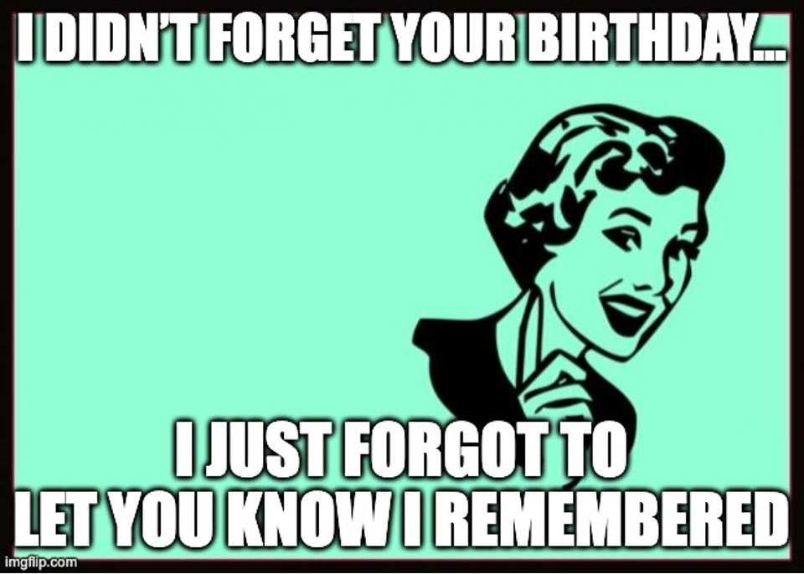

Slide 49
The Dual Write problem
Symptoms
Consumer state slightly out of sync with producer
A few warnings in logs, but no dead-letters
Could not easily reproduce

Slide 50

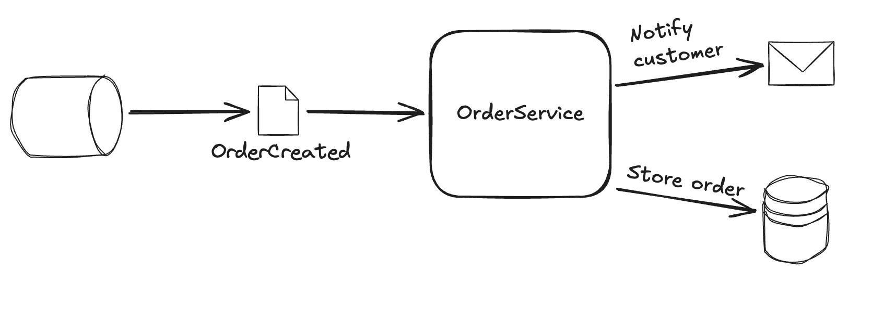
The Dual Write problem
RETRY

Slide 51
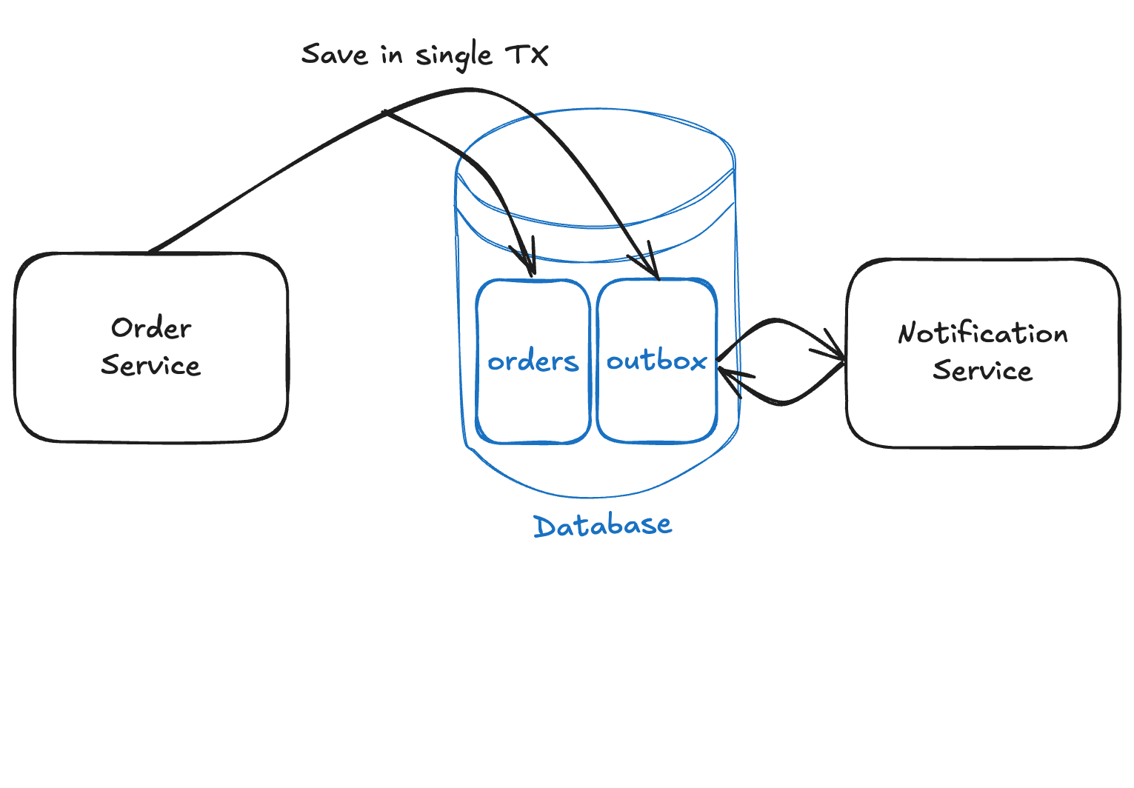
Dual Write – Transactional Outbox

Slide 52
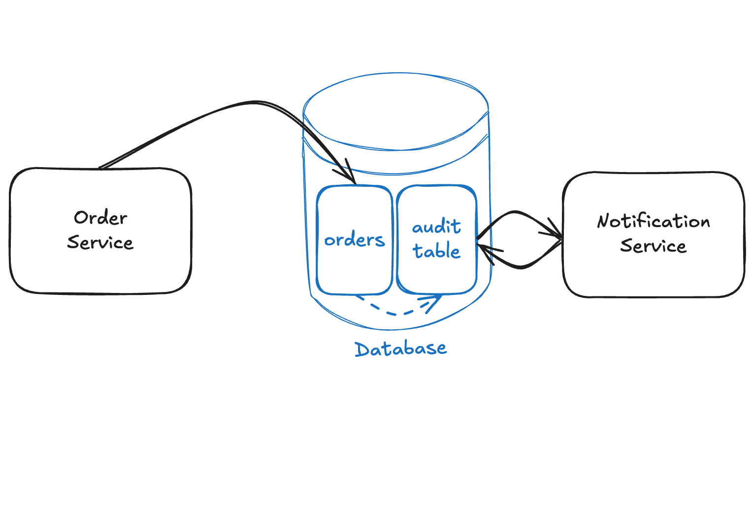
Dual Write – Change Data Capture (CDC)

Slide 53
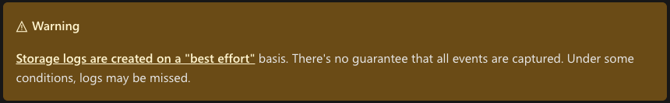
Near-mistake – Azure Functions Blob Triggers
Symptoms
Trigger not firing reliably
Use Azure Event Grid instead
Blob Trigger docs

Slide 54
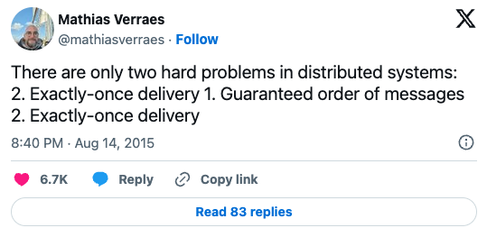
Mistake – Message ordering

Slide 55

Message ordering
Symptoms
State inconsistent with event producer
Zombies

Slide 56
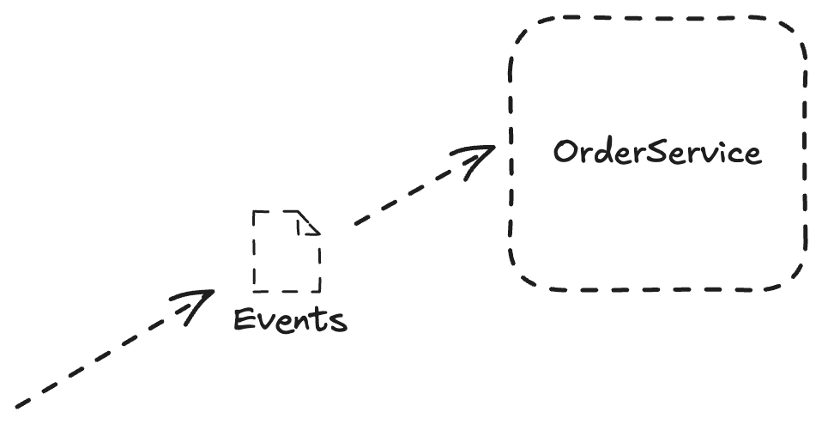
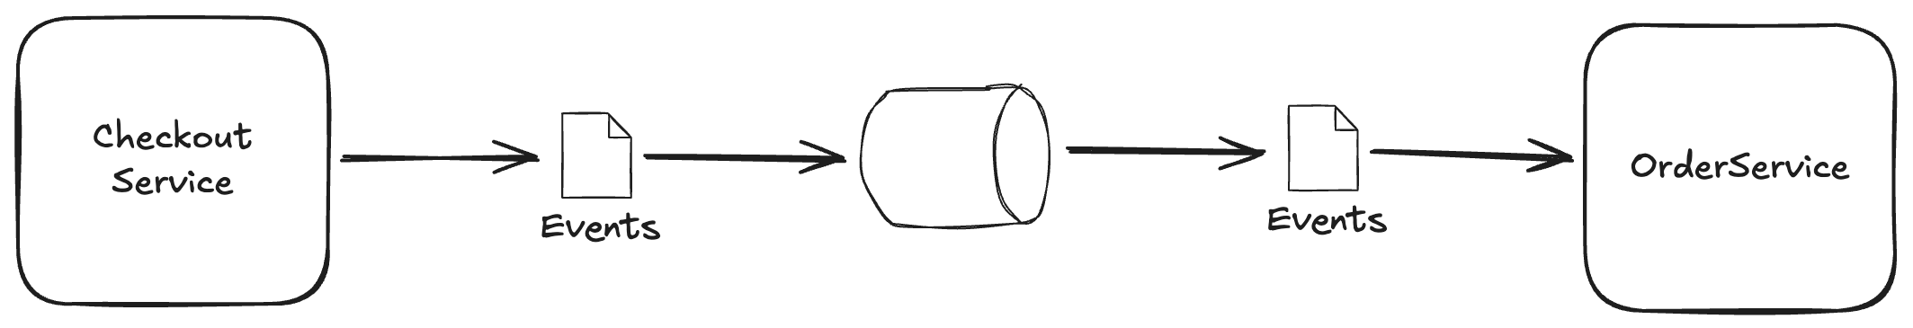

Message ordering
Only trust ordering information from sender
Timestamp / version / sequenceNumber in message

Slide 57
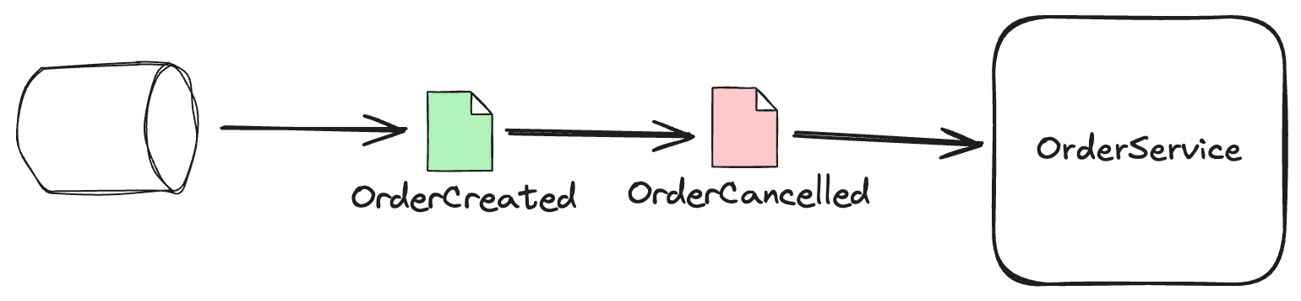
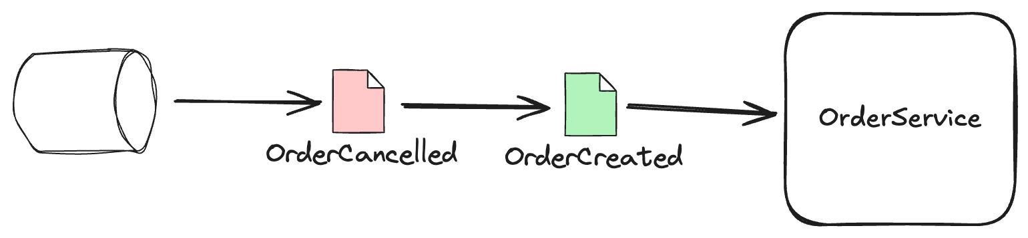
Message ordering - Tombstones
Store the order in state: cancelled
OrderId | CustomerId | Timestamp | Status
17 | 42 | 2024-09-05-17:31 | Cancelled
… | ... | … | …

Slide 59
Takeaways
Events are not equally important
Events are hard
Don’t reinvent the wheel
Store events for debugging
Test at production scale and volume
Do your own homework
Understand configuration
Understand the limitations of the messaging service
Think carefully about what can go wrong
Look out for Dual Write problems
Don’t trust message arrival order

Slide 60
Other mistakes
Idempotency bugs
Concurrency and race-condition bugs
Eventual consistency bugs
Accepted poor event schemas from producers
Versioning of own event schemas

Slide 61
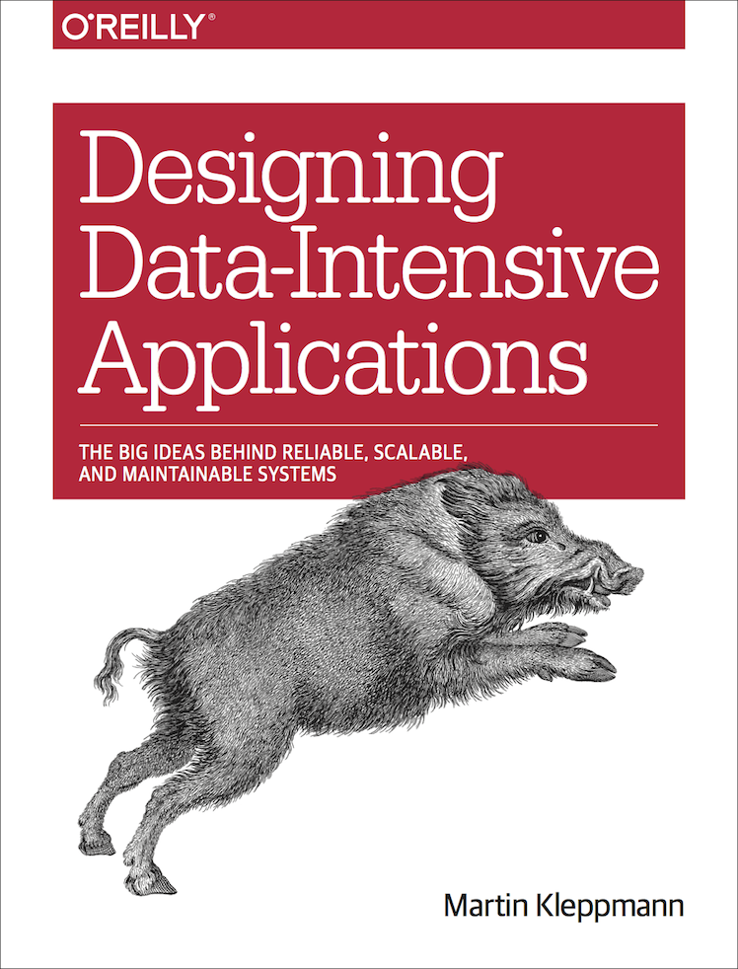
Resources
CodeOpinion.com @ YouTube
DDIA book by Martin Kleppmann
microservices.io

Slide 62
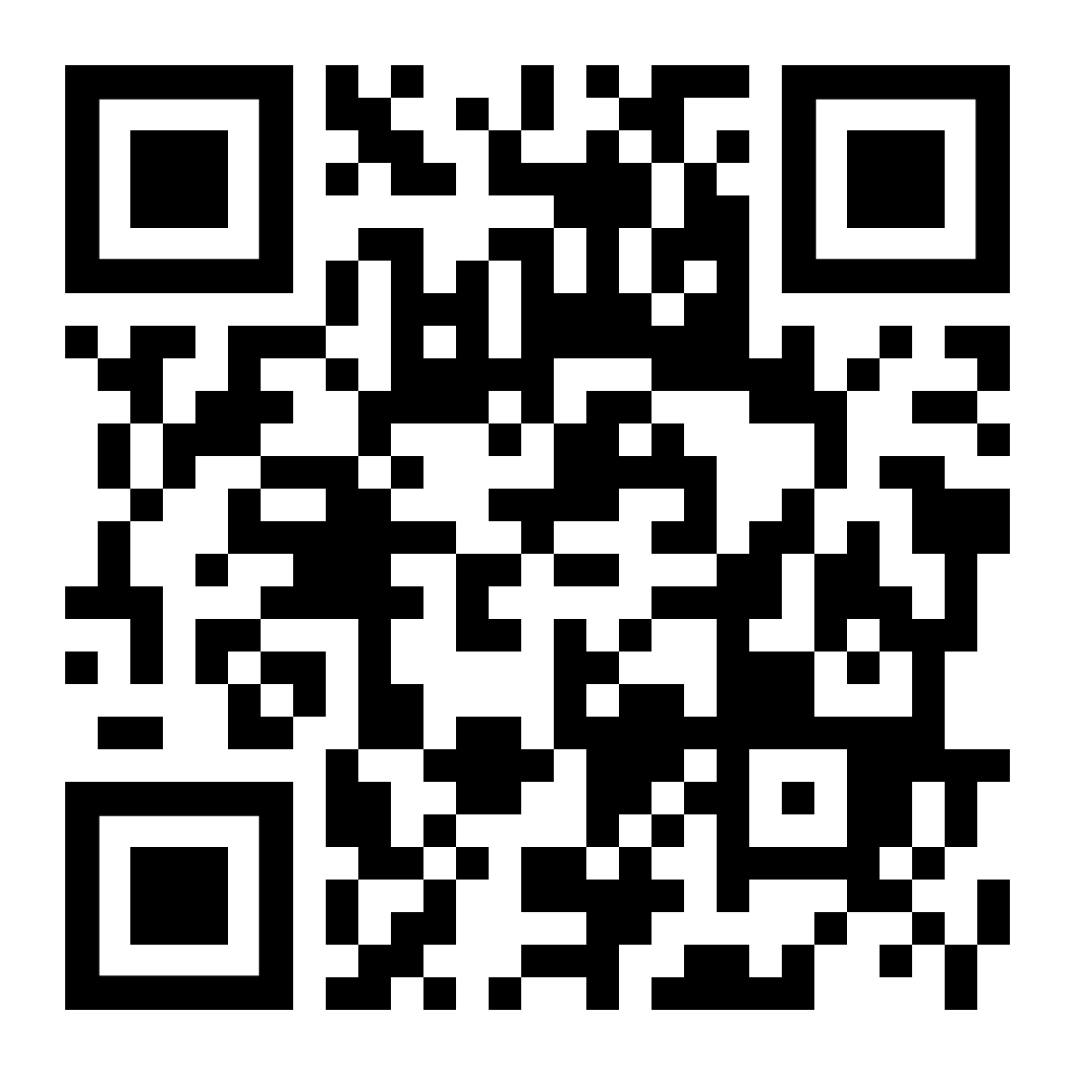
Slides

Slide 63
?

